Slide 1
An Introduction and Overview of Privacy-Enhancing Technologies for Data Processing and Analysis
07.08.2023, Bachelor Thesis Final Presentation
Jared Fantaye

Slide 2
Outline
Introduction & Motivation
Research Questions
Methodology
Key Results
Limitations and Future Work

Slide 3

Privacy-Enhancing Technologies
“Privacy-Enhancing Technologies (PETs) are technologies that embody fundamental data protection principles by minimising personal data use, maximising data security, and/or empowering individuals.” - Information Commissioner’s Office*
Illustration by FreePik (https://storyset.com/)
*Source: “Chapter 5: Privacy-enhancing technologies (PETs)” (2022) by ICO (https://ico.org.uk/media/about-the-ico/consultations/4021464/chapter-5-anonymisation-pets.pdf)

Slide 4
Motivation
Lack of awareness
Complexity of the technologies
Regulations do not explicitly mandate the use of Privacy Enhancing Technologies
Lack of understanding and adoption of Privacy-Enhancing Technologies in the industry
→ Essential to address this issue to guarantee privacy and data sovereignty

Slide 5



Research Questions
What are the most prevalent PETs for data processing and analysis?
What are the characteristics, benefits, challenges, and applications of the selected PETs?
How can one convey this information in a meaningful and engaging manner to ensure a better understand-ding of the selected PETs?

Slide 6
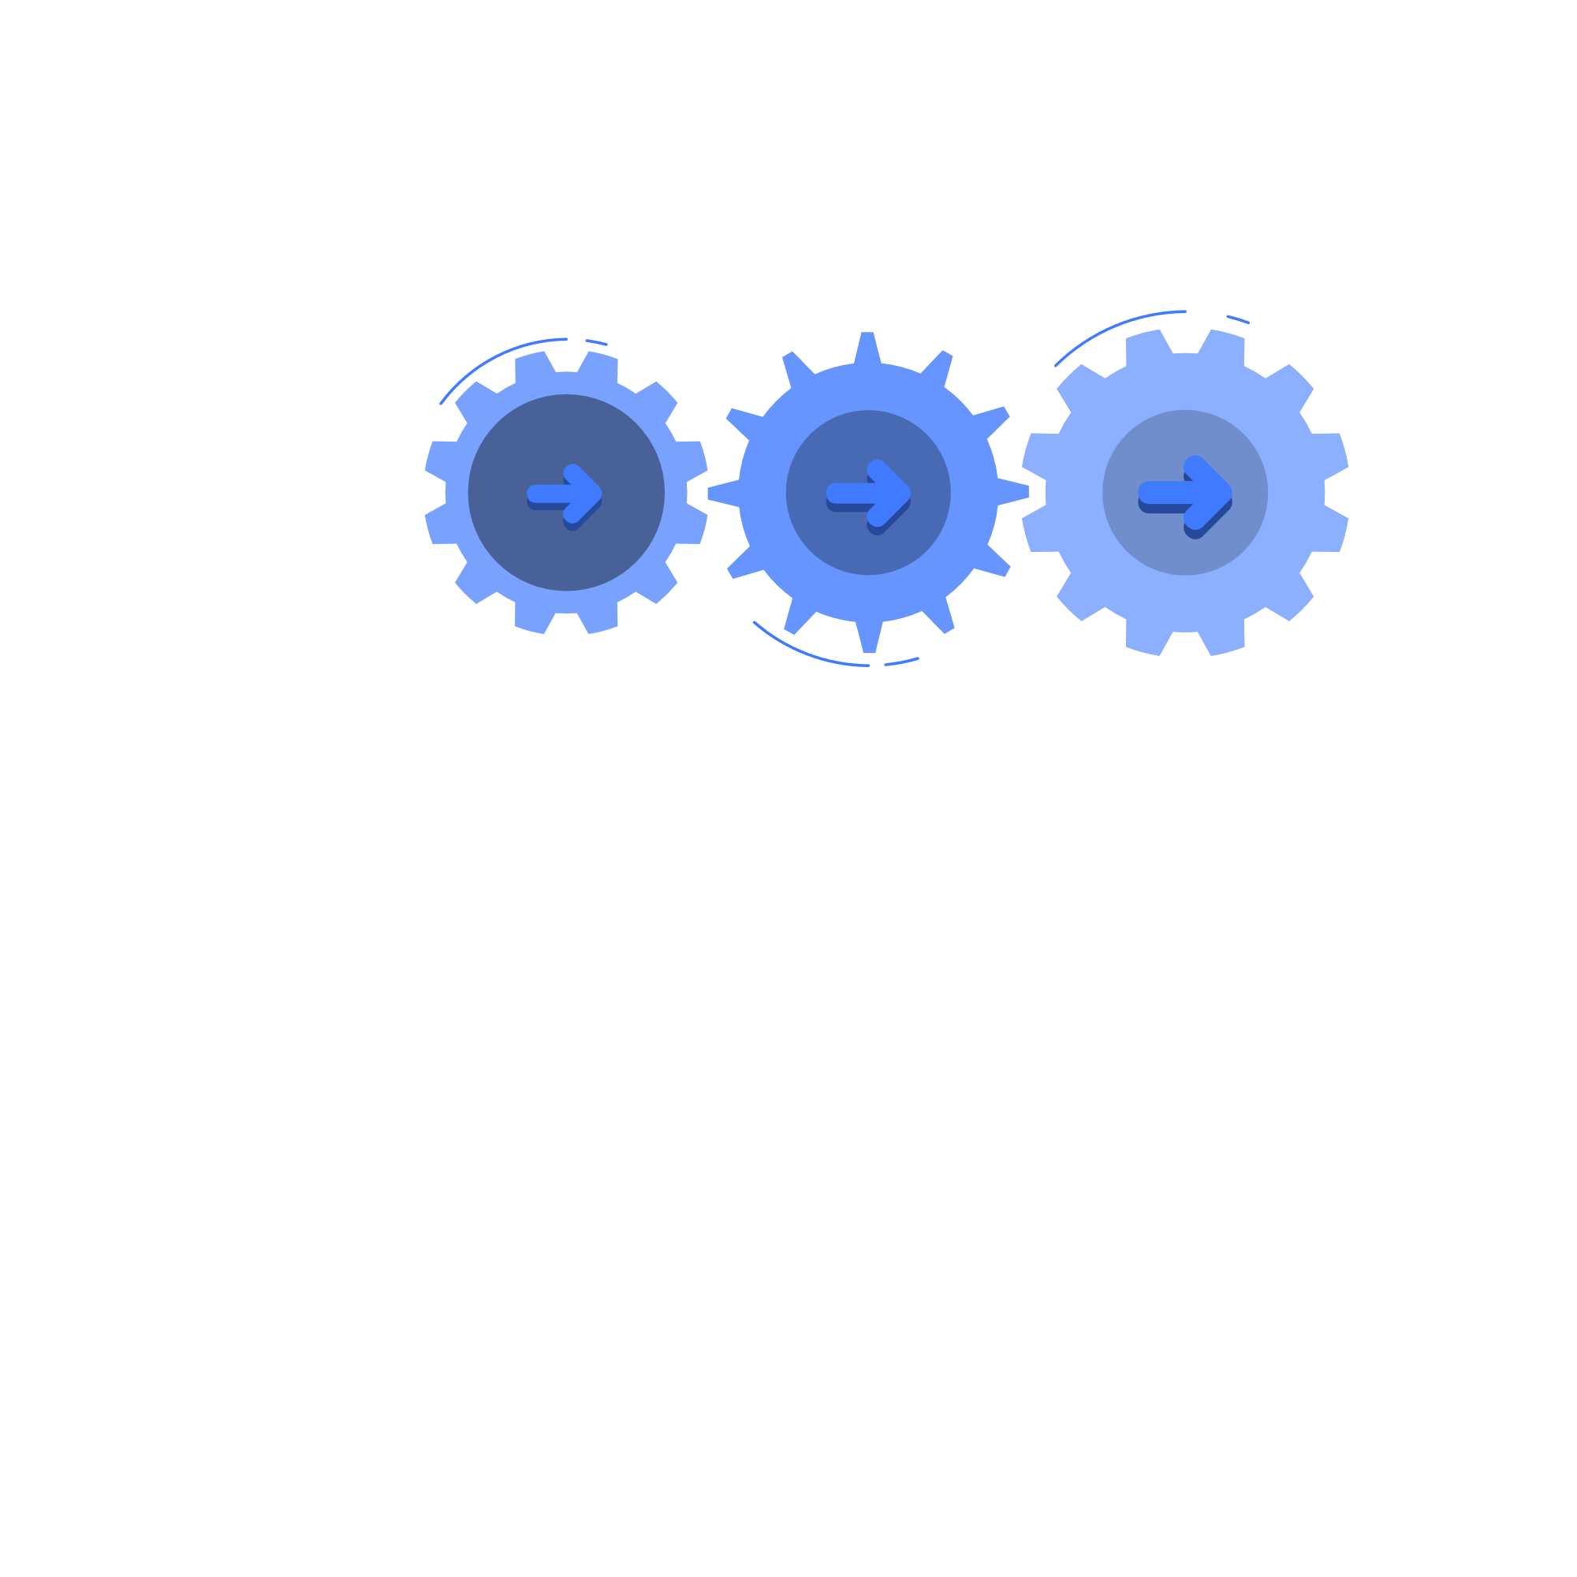
Methodology
Quantitative Analysis
Systematic Literature Review
Conduct a systematic literature review to identify characteristics, benefits, and shortcomings of each PET
Learning Content
Create learning paths and a quiz based on the identified PETs
Identify the predominant PETs through a quantitative analysis of existing literature

Slide 7
Quantitative Analysis: Methodology
Scope of Quantitative Analysis
Search Timeframe: 2013 - Present
Publication Types: Conference papers, academic journals, and research articles
Search Method: Targeting "[PET]" in article titles, abstracts, and author keywords
Databases
IEEE Xplore
Scopus
ACM Digital Library
ScienceDirect

Slide 8
Quantitative Analysis: Results

Slide 9
Systematic Literature Review: Methodology
Search Methodology
Inclusion/Exclusion criteria
Databases:
IEEE Xplore
Scopus
ACM Digital Library
Search strategy:
Automated searches using search strings derived from the research question
  (”[PET]”)
  (”[PET]”) AND (”overview” OR “introduction” OR “basics” OR “fundamentals” OR “concepts” OR “principles”)
  (”[PET]”) AND (“applications” OR “benefits” OR “challenges”)
Inclusion criteria:
Papers have to be relevant and readily used in current literature (has to be published within the last 10 years)
Papers that talk about the characteristics, benefits and challenges of the PETs in context of data processing and analysis.
Exclusion criteria:
Papers focused on legal requirements or policies instead of the technologies
Papers that talk in detail about a very specific implementation or use case of a PET will not be considered
Papers that provide no useful information to a non-technical audience.

Slide 10
Systematic Literature Review: Results
 | Federated Learning | Differential Privacy | Homomorphic Encryption | Secure Multi-Party Computation | Zero-Knowledge Proofs
Definition & Characteristics | Federated Learning allows ML models to be trained without the need to store raw data in a central location. This is achieved by shifting the responsibility of training the model from the central server to the clients. | Differential Privacy is a rigorous mathematical definition of a privacy goal. It can be accomplished by adding random noise to raw data in order to protect the sensitive information of the individual participants. | Homomorphic Encryption is an encryption scheme in which the data remains encrypted even during processing. This means that a third party who is not authorized to read the data can still perform useful operations on the ciphertext. | Secure Multi-Party Computation enables multiple parties to perform a joint computation without disclosing any of their private inputs in the process. The calculation is performed by the participants, so there is no need to entrust the data to a central entity. | Zero-Knowledge Proofs allow one entity (the prover) to prove to another entity (the verifier) that a particular statement is true, whereby no information is disclosed to the verifier other than the fact that the prover's statement is true.
Benefits | Privacy, Security, Legal & Regulatory Compliance, Improved Model Performance & Predictions, Cost Reduction, Scalability | Privacy, Security, Legal & Regulatory Compliance, Versatility, Customizability, Accessibility, Lightweight Computations, Data Preservation | Privacy, Security, Legal & Regulatory Compliance, Secure Outsourcing of Computation | Privacy, Legal & Regulatory Compliance, Efficiency, Quantum-Safe | Privacy, Legal & Regulatory Compliance, Efficiency
Challenges | High Communication Cost, Device Heterogeneity, Data Heterogeneity, Privacy Threats, Security Threats | Trade-Off between Utility & Privacy, Privacy Budget Allocation, High Level of Complexity, Lack of Tools & Standards, Necessity for Change, Small Datasets, No Individual Level of Analysis | Performance Overhead, High Level of Complexity, Scalability Barriers, Constraints on Operations | Performance Overhead, High Level of Complexity, High Communication Cost, Trade-Off between Security and Efficiency | Negative Influences on Efficiency, Non-Deterministic, Quantum Resistance, Lack of Standardization, High Operational Cost
Applications | FL can be used with: Smartphones, IoT Devices, Organizations | Statistical Analysis Machine Learning | Secure Cloud Computation Secure Machine Learning Supply Chain Security | Data Analytics Genetic Testing Secure Auctions | Anonymous Authentication Anonymous Payments Verifiable Computation
Examples | Ai.type (Privacy Breach) Google GBoard Apple Siri | Group Insurance Commission (Privacy Breach) US Census Apple | Cambridge Analytica (Privacy Breach) Banco Bradesco S.A. Facebook | US Communications Satellite Iridium 33 (Accident) Boston Gender Wage Gap Danish Sugar Beet Farmers | LinkedIn (Privacy Breach) Keyless Technologies Z-Cash

Slide 11



Learning Content Development: Methodology
Research Question 3:
How can one convey this information in a meaningful and engaging manner to ensure a better understanding of the selected PETs?
Defining Learning Objectives
Constructing Learning Paths
Developing Quiz

Slide 12
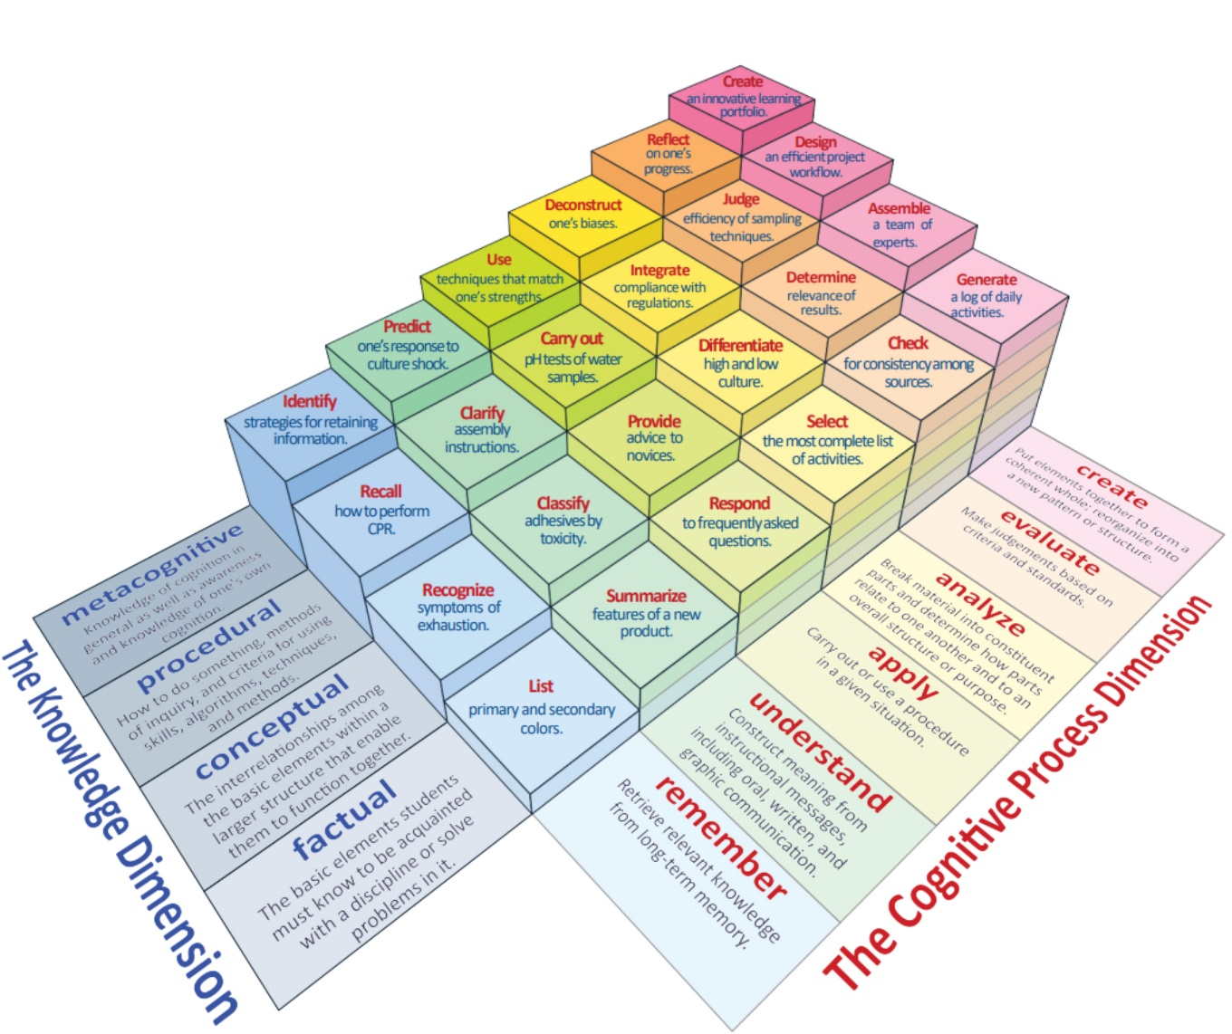
Learning Content Development: Bloom's Revised Taxonomy
Source: “A Model of Learning Objectives–based on A Taxonomy for Learning, Teaching, and Assessing: A Revision of Bloom’s Taxonomy of Educational Objectives” by Rex Heer (https://www.celt.iastate.edu/wp-content/uploads/2015/09/RevisedBloomsHandout-1.pdf)

Slide 13
Learning Content Development: Categories of Bloom's Revised Taxonomy
 | Remember | Understand | Apply | Analyse | Evaluate | Create
Factual Knowledge
Conceptual Knowledge
Procedural Knowledge
Metacognitive Knowledge
Source: “Identification of Educational Needs for the Competent Use of Privacy-Enhancing Technologies” (2022) by Florian Messmer (Bachelor Thesis)

Slide 14
Learning Content Development: Thesis Learning Objectives
The student is able to
list the most predominant PETs in current literature.
explain the features and characteristics of the selected PETs.
describe the benefits and challenges of the selected PETs.
describe the applications and use cases of the selected PETs.
distinguish between PETs and determine which of them is best suited for a particular problem.
state two successful implementations for each PET and an example where a privacy breach occurred that could have been prevented by a successful PET implementation.

Slide 15
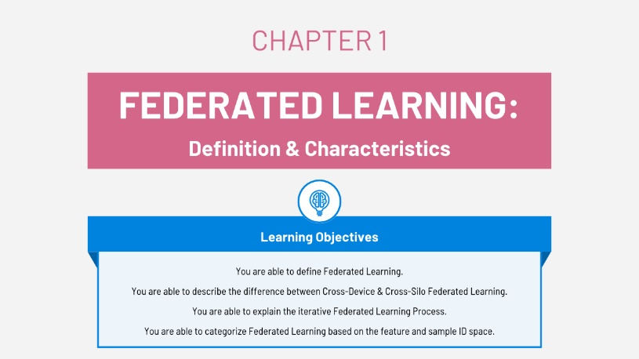
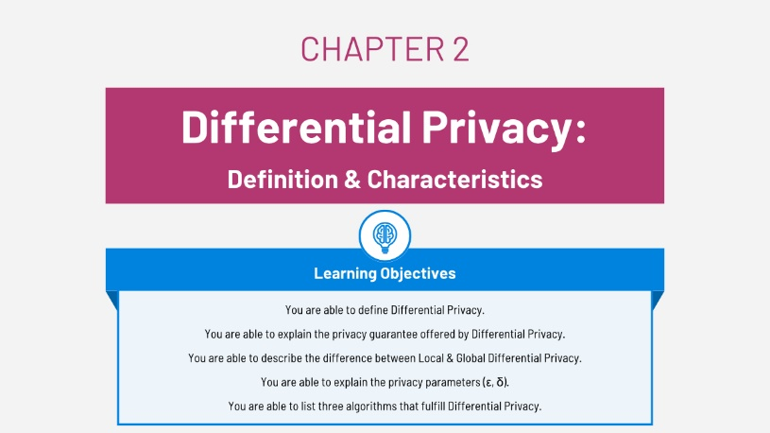
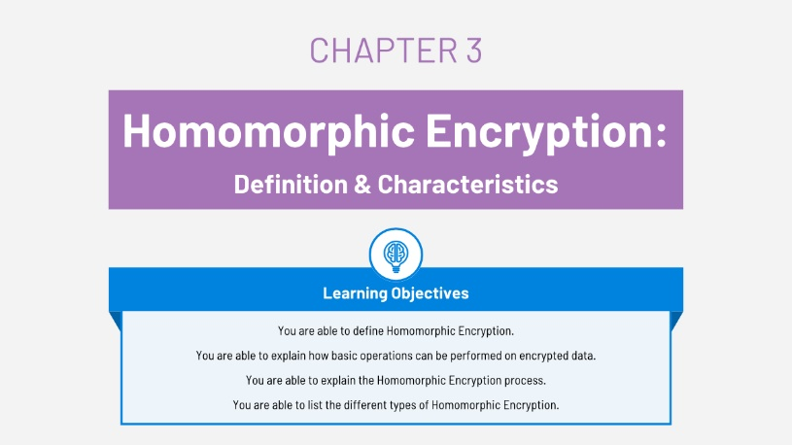
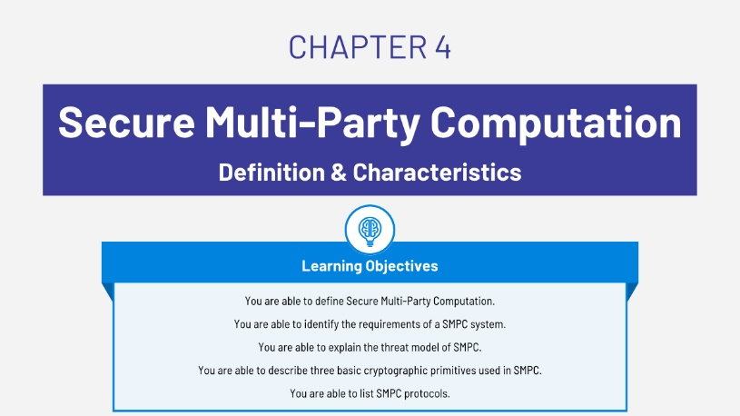
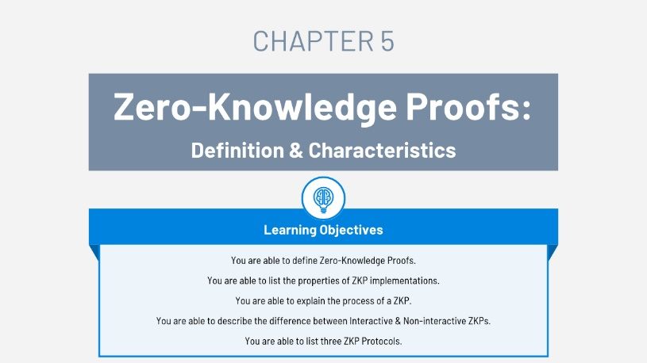
Learning Content Development: Learning Paths

Slide 16
Learning Content Development: Gagné's Nine Events of Instruction
Gagné's Nine Events of Instruction provide a theoretical learning framework designed to help educators develop effective teaching materials. These events attempt to provide guidance on how to create an optimal learning environment by addressing the conditions needed for effective learning.
Gain attention of the students
Inform students of the objectives
Stimulate recall of prior learning
Present the content
Elicit performance
Provide feedback
Assess performance
Enhance retention and transfer
Provide learning guidance
Source: “Gagné's Nine Events of Instruction” (2020) by Northern Illinois University Center for Innovative Teaching and Learning
(https://www.niu.edu/citl/resources/guides/instructional-guide/gagnes-nine-events-of-instruction.shtml)

Slide 17
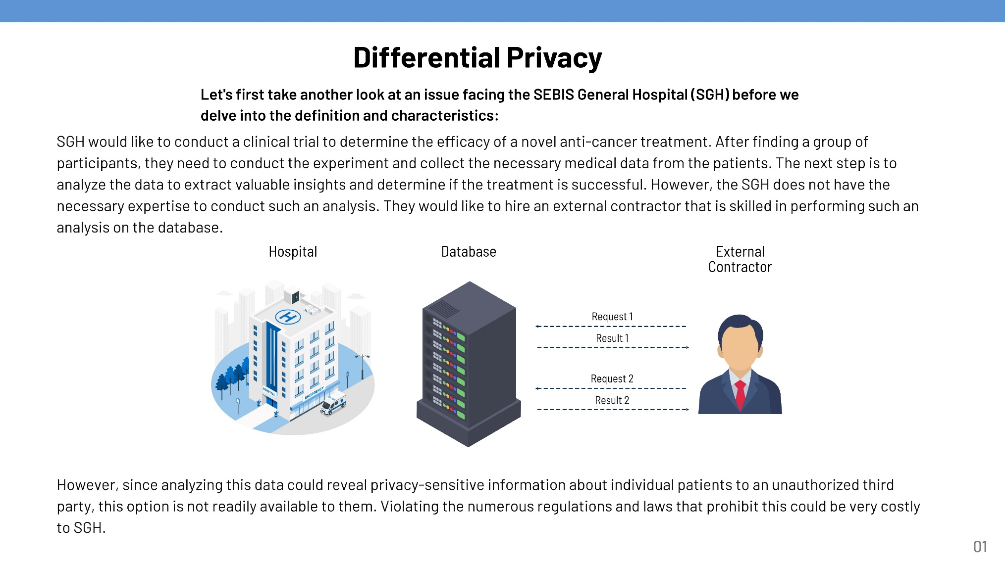
Gagné's Nine Events of Instruction: Gain attention of the students

Slide 18
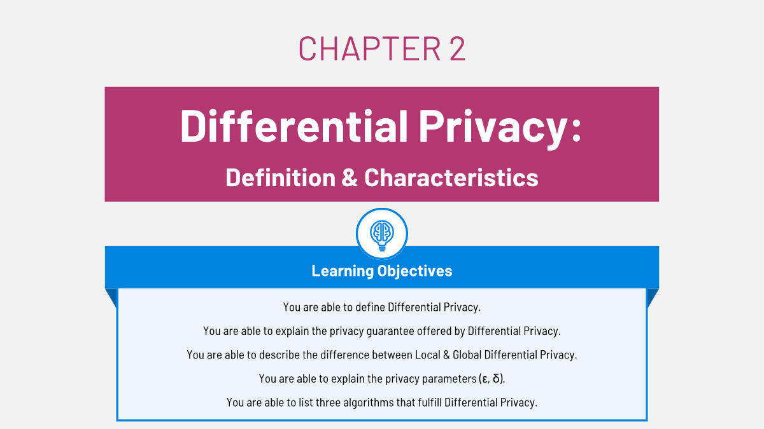
Gagné's Nine Events of Instruction: Inform students of the objectives

Slide 19
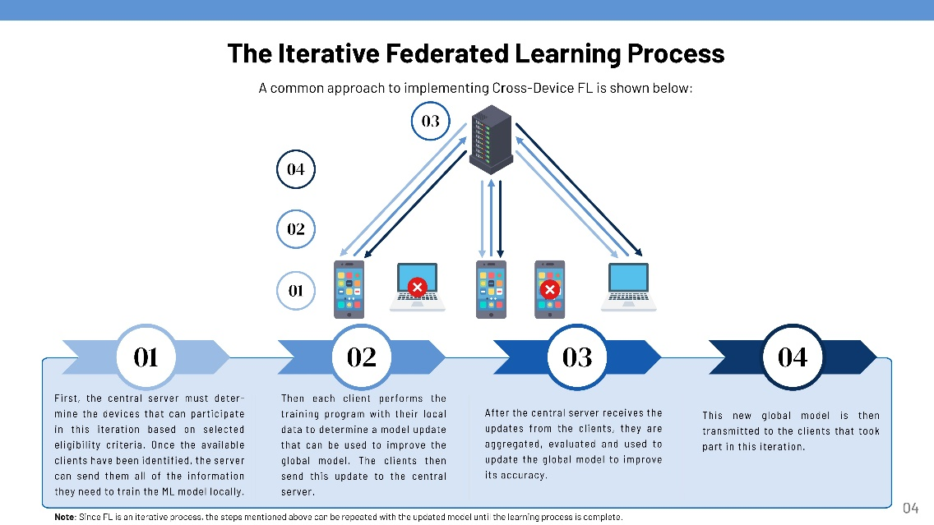
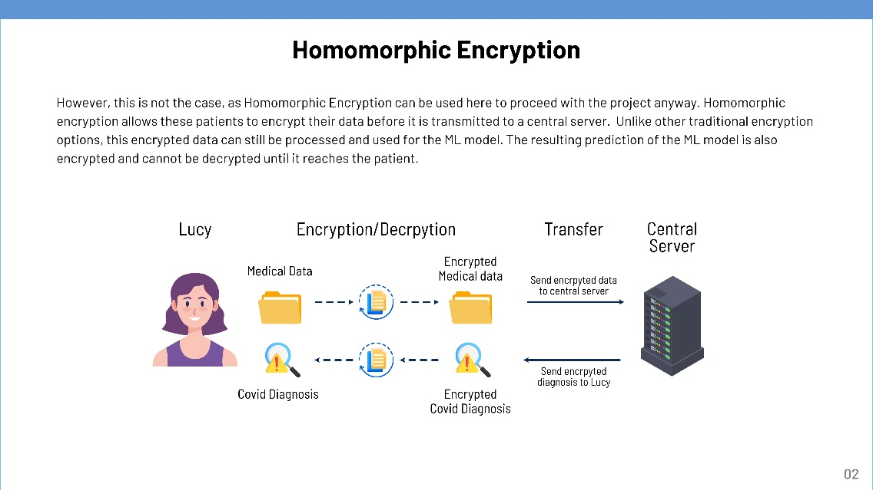
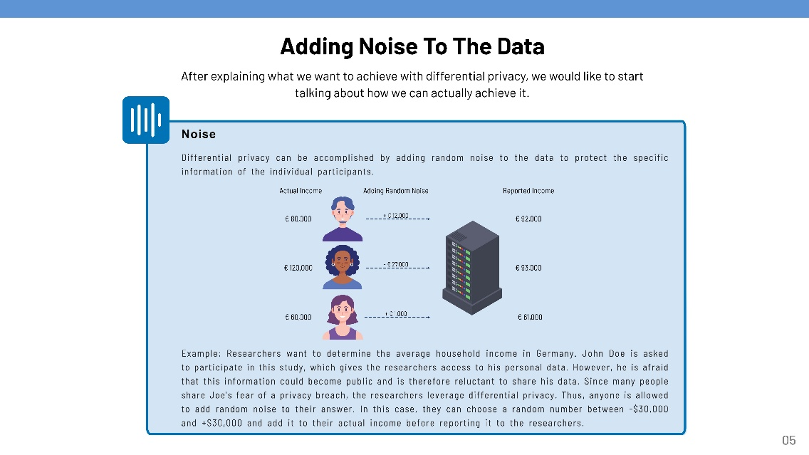
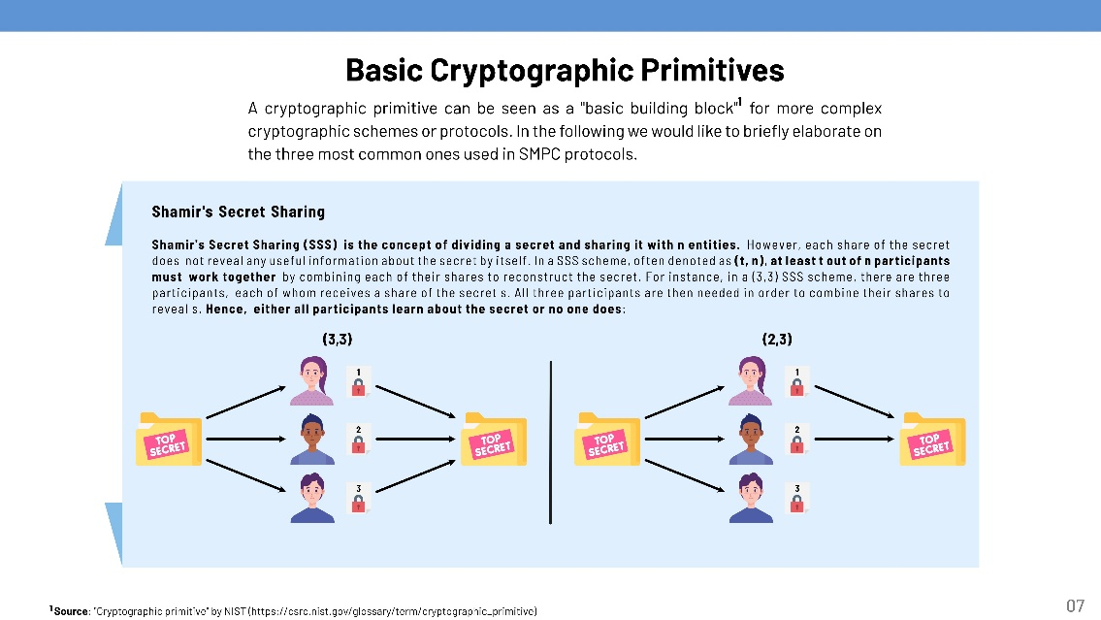
Gagné's Nine Events of Instruction: Present the content

Slide 20
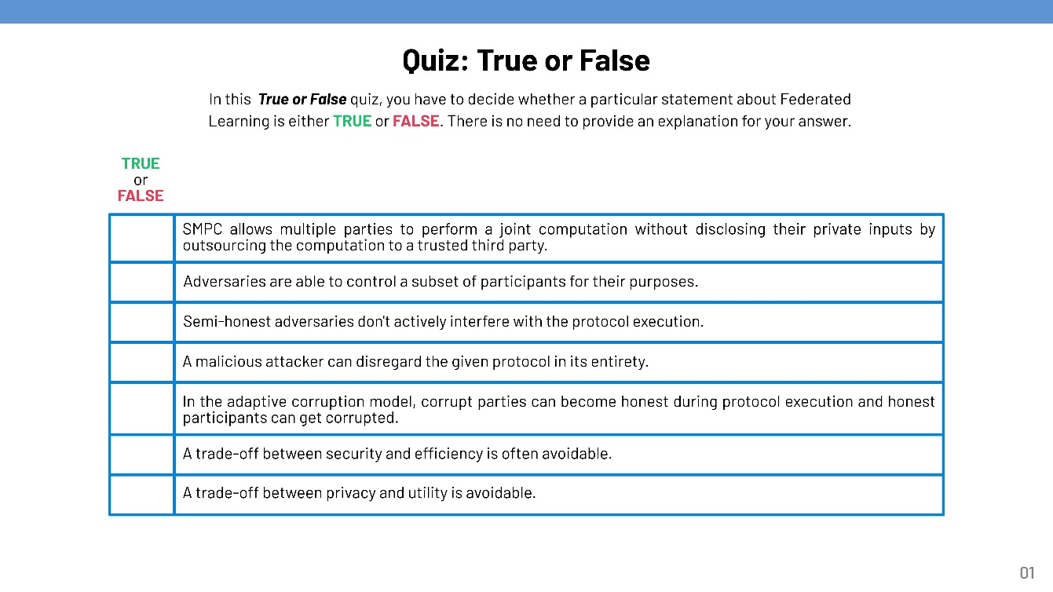
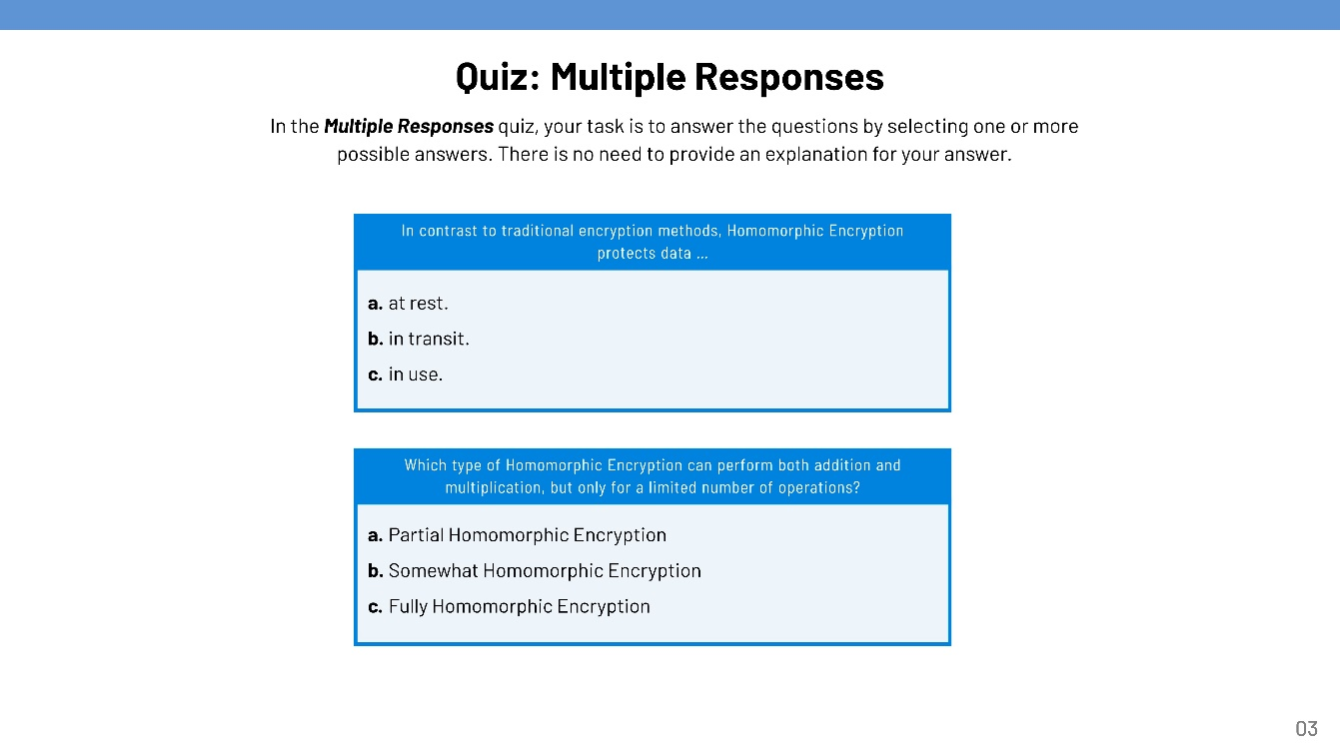
Quiz Development

Slide 21
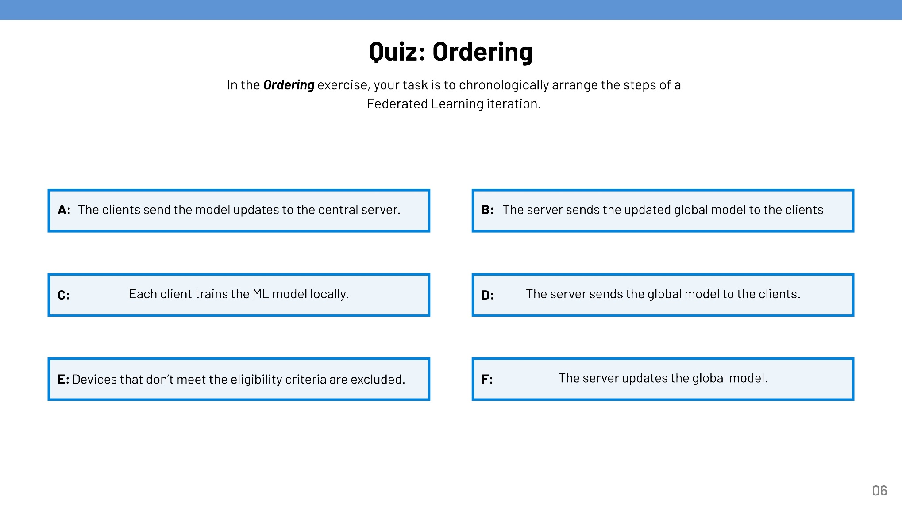
Quiz Development

Slide 22
Key Results
RQ1: What are the most prevalent PETs for data processing and analysis?
RQ2: What are the characteristics, benefits, challenges, and applications of the selected PETs?
RQ3: How can one convey this information in a meaningful and engaging manner to ensure a better understanding of the selected PETs?
Method: Quantitative analysis of current literature
Result:
Identified the five most predominant PETs
Federated Learning
Differential Privacy
Homomorphic Encryption
Secure Multi-Party Computation
Zero-Knowledge Proofs
Method: Systematic Literature Review
Result:
Comprehensive insights into characteristics, bene-fits, challenges, and appli-cations of the selected PETs (see summary of findings on page 10).
Method: Bloom’s Taxonomy and Gagné’s Nine Events of Instruction
Result:
Benefits & Challenges
Applications & Examples
Definition & Characteristics
Total Learning Content: ~200 pages, including quiz.
Learning Paths for each PET, each consisting of three learning nuggets:

Slide 23
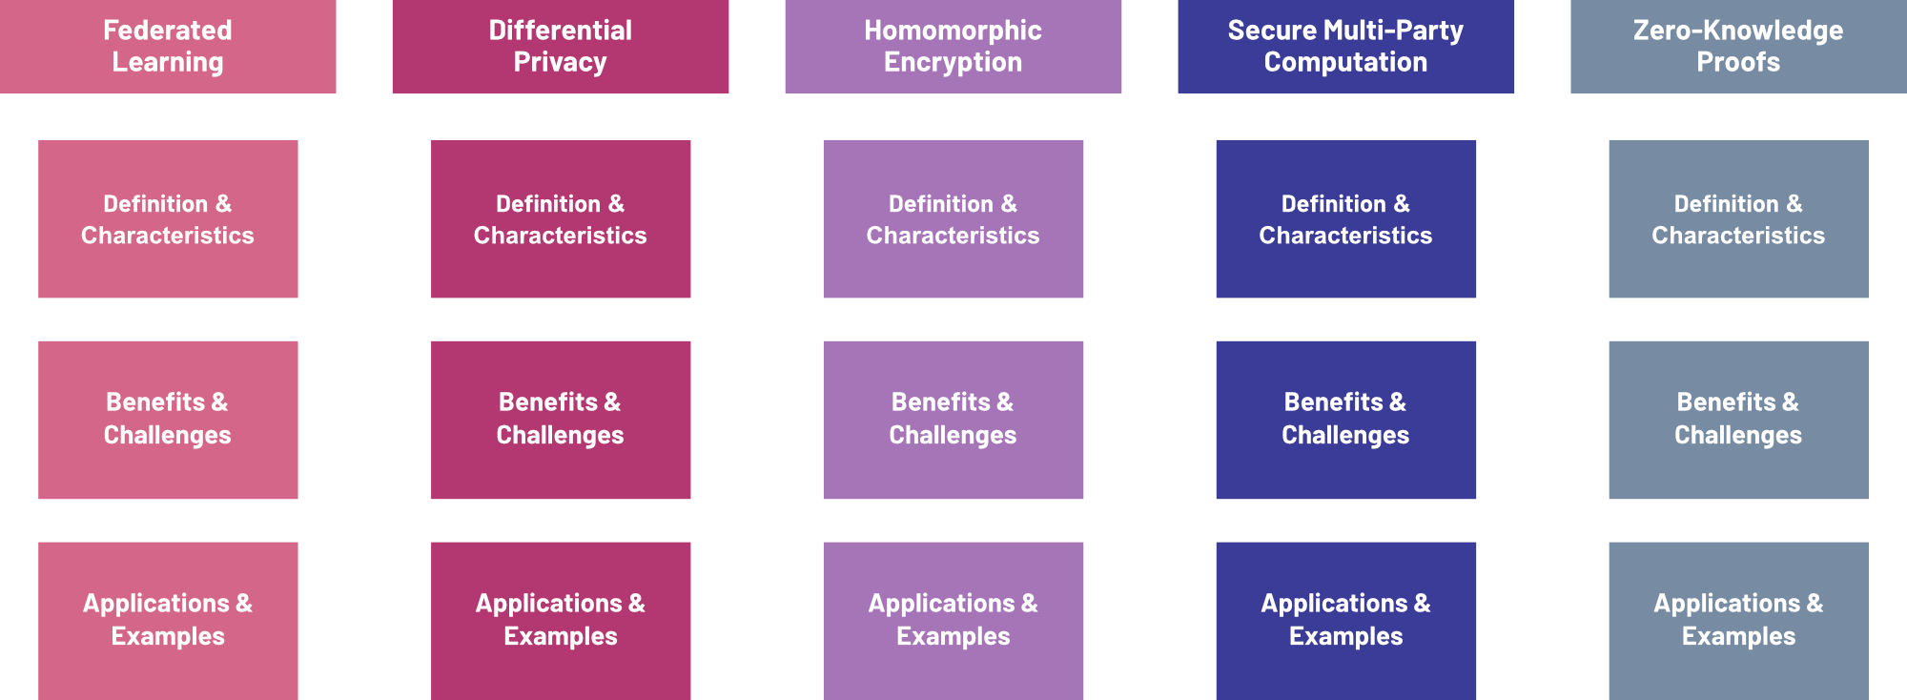
Key Results: Learning Paths & Nuggets

Slide 24
Limitations and Future Work
Non-technical focus may exclude advanced learning needs
Focus on only five Privacy-Enhancing Technologies
Unverified effectiveness of developed learning content
Rapidly evolving technologies and regulations
Provide more advanced educational materials (e.g., detailed guides and best practices for PET implementations).
Expand learning content with additional PETs
Evaluate the learning content's effectiveness for a non-technical audience.
Keep content up-to-date and adjusted to new technological and legal developments.

Slide 25
B.Sc. Candidate
Jared Fantaye
17132
matthes@in.tum.de

